Slide 1

Apache Cloudstack
Dima Ionut Daniel

Slide 2
Contents
What is Apache Cloudstack?
What is Cloud?
Cloud Features
Architecture
Installation
Configuration
High Availability
Bibliography

Slide 3

What is Apache Cloudstack?
CloudStack is open source cloud computing software for creating, managing, and deploying infrastructure cloud services.
It uses existing hypervisors such as KVM, vSphere, and XenServer/XCP for virtualization.
In addition to its own API, CloudStack also supports the Amazon Web Services (AWS) API and the Open Cloud Computing Interface from the Open Grid Forum.

Slide 4
What is Cloud?
Cloud is a shared multi-tenant envinorment build on a highly efficient, automated and preferably virtualized IT infrastructure.
Virtualization is the technology that has made the enablement of these features simpler and convenient.
A cloud can be deployed in various models:
Private cloud:
the cloud infrastructure is operated for an organization.
Public cloud:
the cloud service is provided to be general public or large industry group.
Community cloud:
The cloud is shared by multiple oraganizations and is supported by a specific community
Hybrid cloud:
The deployment model comrpises 2 or more types of cloud (public, private, community)
Enables data and application portability between the clouds

Slide 5
Cloud Features
A cloud has the following features:
On-demand serlf-service
Broad network access
Resource pooling
Rapid expansion
Measured service
Shared by multiple tenants

Slide 6
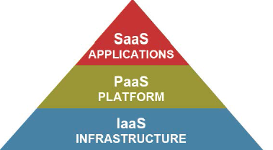
Cloud Features (cont.)
Cloud has 3 possible service models:
Infrastructure as a service(Iaas):
Provides IT infrastructure resources as a service to the end users.
The provider manages and controls the cloud infrastructure and the user has control over the OS, storage, applications.
Platform as a service(PaaS) :
The end user is provided with a platform that is provisioned over the cloud infrastructure.
Software as a service(SaaS) :
The layer provides software as a service to the end users.
The end users can access these sogtware using a thin client interfaces(such as a web browser).

Slide 7
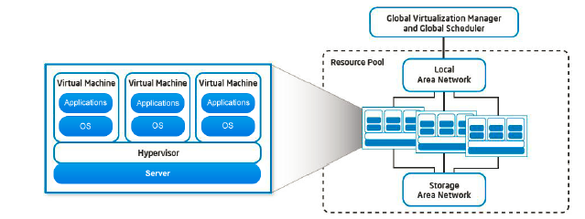
Cloud Features (cont.)
The storage is accessible to the Compute Layer.
The Storage in the cloud envinorments is accessed throught the virtualization layer.
Pooled, virtualized storage is enabled through technologies such as Network Attached Storage(NAS) and Storage Area Network(SAN).

Slide 8
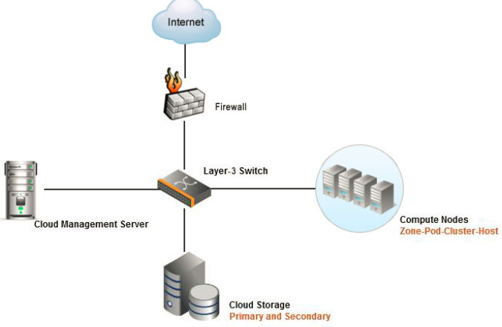
Architecture
CloudStack is a solution or a platform for IT infrastructure as a service that allows to pool computing resources.
It can be used to build public, private or hybrid IaaS cloud services .

Slide 9
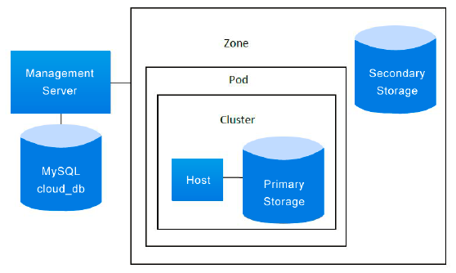
Architecture (cont.)
The CloudStack deployment model covers the basic components of CloudStack.
It also covers the logical segregation of resources to help better manage them.

Slide 10
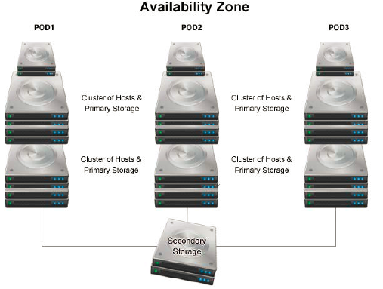
Architecture (cont.)
Zones are the highest level of hierarchy in which the datacenter of an organization is logically partitioned to provide physical isolation and redundancy.
A zone is divided into various other logical units:
1 or more pods:
a pod is the second level of hierarchical unit which can contain 1 or more clusters.
Secondary storage:
storage that is shared by all pods in a zone.

Slide 11
Architecture (cont.)
A pod is the second level of hierarchy in the deployment of the CloudStack.
A pod contains one or more clusters and a cluster in turn contains 1 or more hosts.
A cluster is the third level of hierarchical division in the deployment of CloudStack inside pods.
The hosts are grouped into a logical group called clusters.
Volumes are the basic unit of storage in CloudStack.

Slide 12
Architecture (cont.)
The CloudStack management server helps to mange the IT infrastructure.
It provides a single point of configuration for the cloud.
Basic functionalities of the management server:
Web user interface for administration.
API for the CloudStack .
The public /private IP addresses to particular accounts.
Storage to guests as virtual disks is allocated by management server.
Functionalities such as snapshots, templates and ISO images.
Acts as single point of configuration

Slide 13
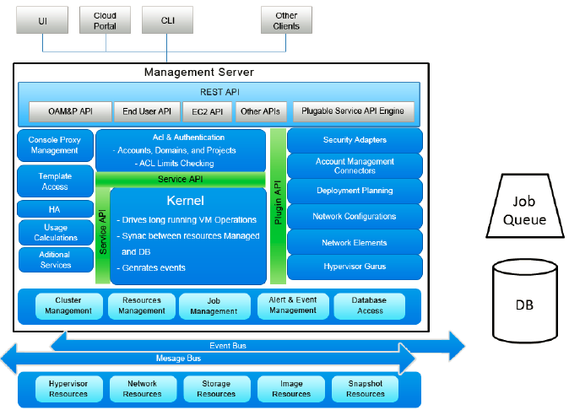
Architecture (cont.)

Slide 14
Architecture (cont.)
Management server basic units:
Interface:
User interface and application program interface
Busines Logic:
If a user requests a VM using the API or UI, the request is passed through the business logic
Orchestration Engine:
Orchestration engine is critical to the CloudStack deployment
Used for configuring, provisioning and scheduling operations
Controllers:
Basic underlying parts of the CloudStack management server.

Slide 15
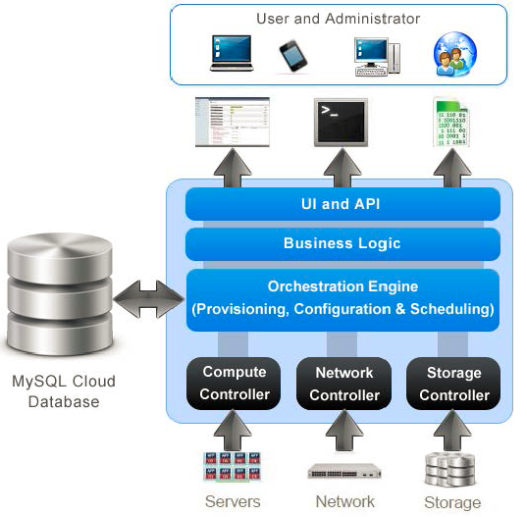
Architecture (cont.)
The CloudDB is the primary MySQL database that is used by management server.
The CloudStack management server communicates with the master database and the replicas are in sync with the master.

Slide 16
Installation
The CloudStack deployment architecture basically consists of two major parts:Management Server and CloudDB.
CloudStack can be deployed in 2 ways:
Single node installation:
there is only one instance of management server
the database server can be on the same node or different node
Multinode installation:
multiple managemetns ervers and 1 or mant DB servers
CloudStack 4.0 is recommended to be deployed on:
RHEL 6.3 +64bi
CentOS 6.3 + 64 bit
Uibuntu 12.04 LTS

Slide 17
Installation (cont.)
CloudStack 4.0 is recommended to be deployed on:
RHEL 6.3 +64bi
CentOS 6.3 + 64 bit
Uibuntu 12.04 LTS
Basic hardware configuration:
CPU:
64-bit X86 CPU
Memory:
at least 4 Giga memory
Hard disk:
at least 36 GB; for better performance 500GB.
Network:
at least one network interfaces card and there should be a static IP address associated.

Slide 18
Installation (cont.)
Set FQDN(Fully Qualified Domain Name) using hostname.
Set SELinux to be permissive by default. (setenforce permissive) and se save the option for the next reboot (selinux-config-enforcing permissive).
Install NTP(Network Time Protocol) service and start the service.
Get the Apache CloudStack packages(*.deb or rpms) or generate them from sources(maven,java,dpkg-buildpackage,etc are required).
Install cloud-client package

Slide 19
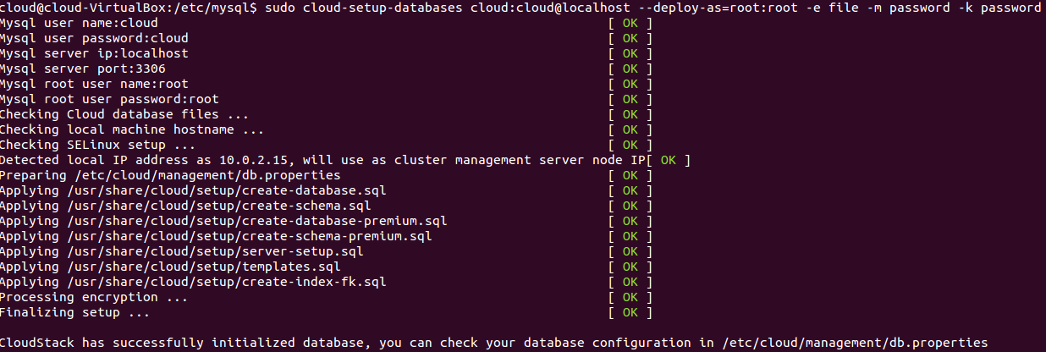
Installation (cont.)
Install Mysql 5.6 server, customize server and run the cloud-setup-databases command.

Slide 20
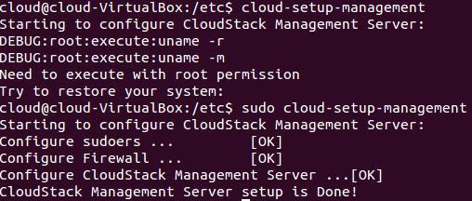
Installation (cont.)
Install NFS server and configure.
Run the cloud-setup-management to configure CloudStack Management server.
The latest step is to prepare the System VM Template, by using the following sample command:
/usr/lib/cloud/common/scripts/storage/secondary/cloud-install-sys-tmplt -m /mnt/secondary -u http://download.cloud.com/templates/burbank/burbank-systemvm-08012012.ova -h vmware -s cloud -F

Slide 21
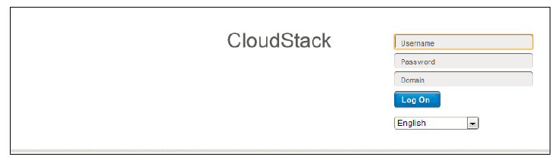
Configuration
Web URL: http://<management-server>:8080/client
The UI can be used for administration purposes:
provision,view and manage cloud infrastructure
create,update,manage or delete new domains
create,update,manage users
create,update,manage projects

Slide 22
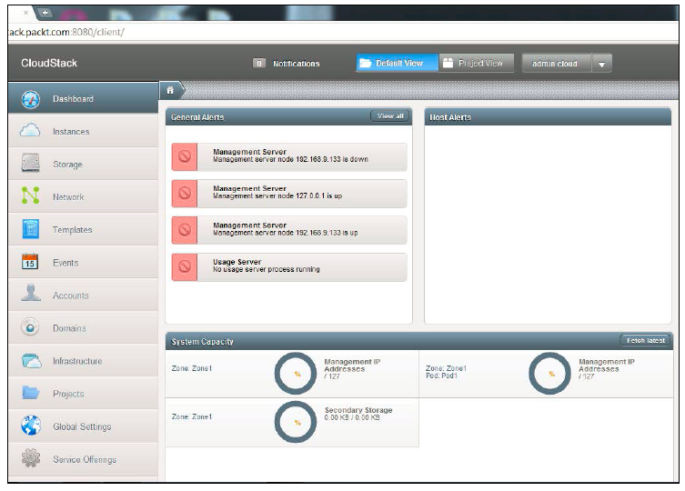
Configuration (cont.)

Slide 23
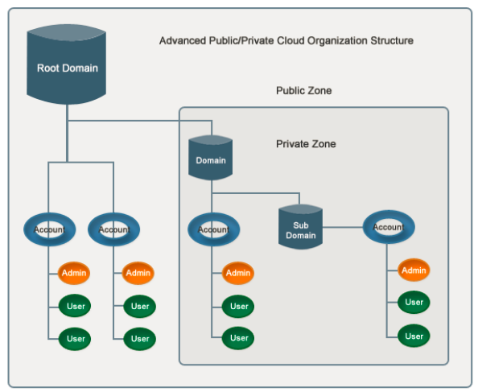
Configuration (cont.)
Domains, projects, accounts and users are various terms used in CloudStack.
RBAC it's an essential mechanism to provide different access permissions to different users.
Domain are similar to the domains in LDAP.
They are a group of accounts that are connected by relationship.

Slide 24
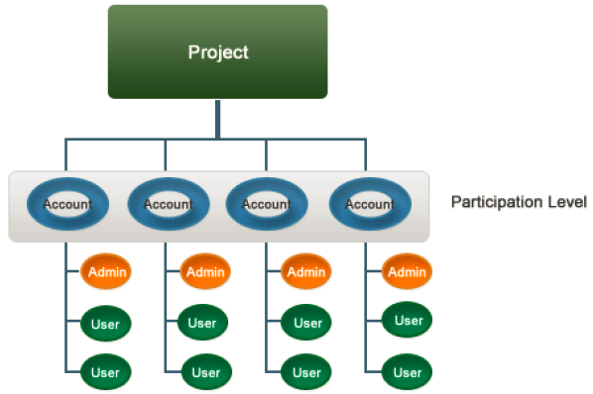
Configuration (cont.)
CloudStack provides a feature for creation of projects to that cloud users can divide their work into groups.
Projects allow the users to share the control of resource between multiple accounts.

Slide 25
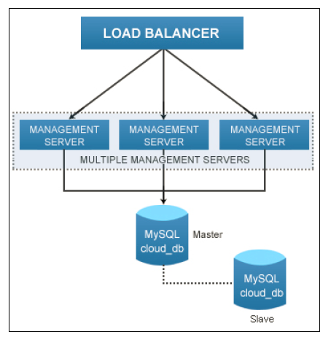
High Availability
HA is an important aspect in a cloud computing envirnoment.
Ensures minimum downtime of the cloud service and the applications using the cloud envirnoment.

Slide 26

Bibliography
PacktPub - Apache CloudStack Cloud Computing
http://en.wikipedia.org/wiki/Apache_CloudStack

